Slide 1

软件工程专业英语
计算机科学学院
School of Computer Science
Unit 4：Working in a Team

Slide 2
Outline
Part 1, Dialogue: Team Structure
Part 2, Translating: The Internet of Things

Slide 3
Part 1, Dialogue: Team Structure
Main content
主要讨论了如何进行团队合作
1）Extreme Programming：强调无障碍沟通、快速交付结果
2）另一种方式：围绕软件开发的三个主要任务，即，管理相关的、开发相关的、测试相关的。
强调团队成员保持良好沟通的重要性
代码版本控制管理

Slide 4
Jason: Considering our situation, we can try Extreme Programming (XP) in the development process, which advocates communication without any obstacles and leads to a quick delivery. It is very appropriate to the characteristics of our team and project.
Sharon: You are right. With XP, we can cooperate with each other and focus our time and energy, which is needed to succeed.
Extreme Programming (XP): 极限编程
The first Extreme Programming project was started March 6, 1996. Extreme Programming is one of several popular Agile Processes. It has already been proven to be very successful at many companies of all different sizes and industries world wide.
XP is featured with short development cycles. It usually involves four activities: coding, testing, listening, and designing. It advocates five values: communication, simplicity, feedback, courage, and respect.

Slide 5
Jason: Considering our situation, we can try Extreme Programming (XP) in the development process, which advocates communication without any obstacles and leads to a quick delivery. It is very appropriate to the characteristics of our team and project.
Sharon: You are right. With XP, we can cooperate with each other and focus our time and energy, which is needed to succeed.
advocate [ˈædvəkeɪt ]
vt. 提倡; 鼓吹; 拥护; 为…辩护
n. 提倡者;（辩护）律师; 支持者
1. The group does not advocate the use of violence.
该团体不支持使用暴力。
2. He was a strong advocate of free market policies and a multi-party system.
他是自由市场政策和多党派制度的坚决拥护者。

Slide 6
Kevin: As I know, there is another team structure which recognizes that there are three main task categories in software development—management related, development related, and testing related. In this way, we can clearly divide our work into those three main aspects. Jason mainly focuses on development, Sharon conducts testing and I'm responsible for the management of our project, so that we can carry out the task more professionally.
Sharon: Sounds good! Well, let's do it!

Slide 7
Jason: Besides, in our daily work, good communication between members of a development group is essential. We must exchange information on the status of respective work, the design decisions that have been made and changes to previous decisions that are necessary.
Sharon: To accomplish this, we'd better establish some mechanisms for formal and informal communication among us. Formal communication can be accomplished through writing documents and progress reports. On the other hand, we can share ideas via Internet at anytime informally.

Slide 8
Kevin: In addition, since we develop synchronously and cooperatively, we need a configuration management mechanism in order to ensure the consistency of our work.
Jason: Yes. Maybe some automatic tools can help us with that.
Sharon: CVS, short for Concurrent Versions System, is one of the industry's most widely used version control systems, and is very fit for the size and characteristics of a development team like ours. We can give it a try.
Kevin: Ok, I agree.
synchronous 同步的
asynchronous 异步的
synchronization 同步
asynchronization 异步
synchronize 使同步
asynchronize 使异步
be appropriate for/to sth
对…合适、恰当
be fit/proper/suitable/acceptable for
In order to use it successfully, you must create a process configuration that is appropriate for your project.
为了成功地使用它，您必须创建一个适合您的项目的过程配置

Slide 9
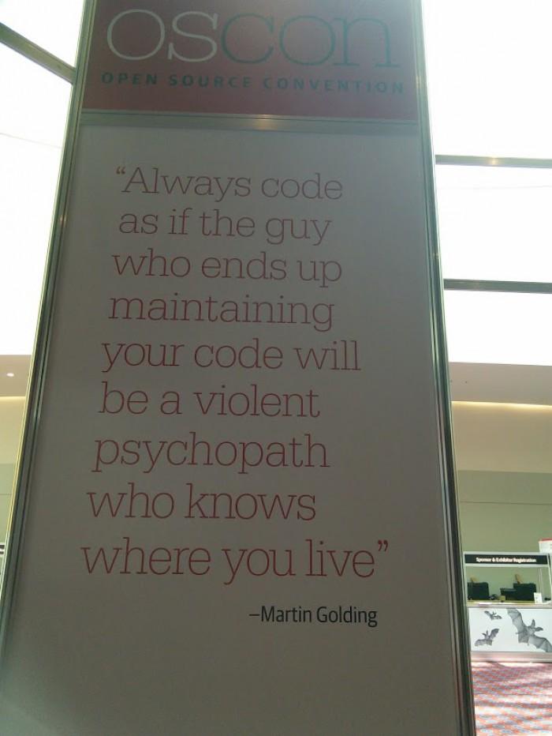
How to code?

Slide 10
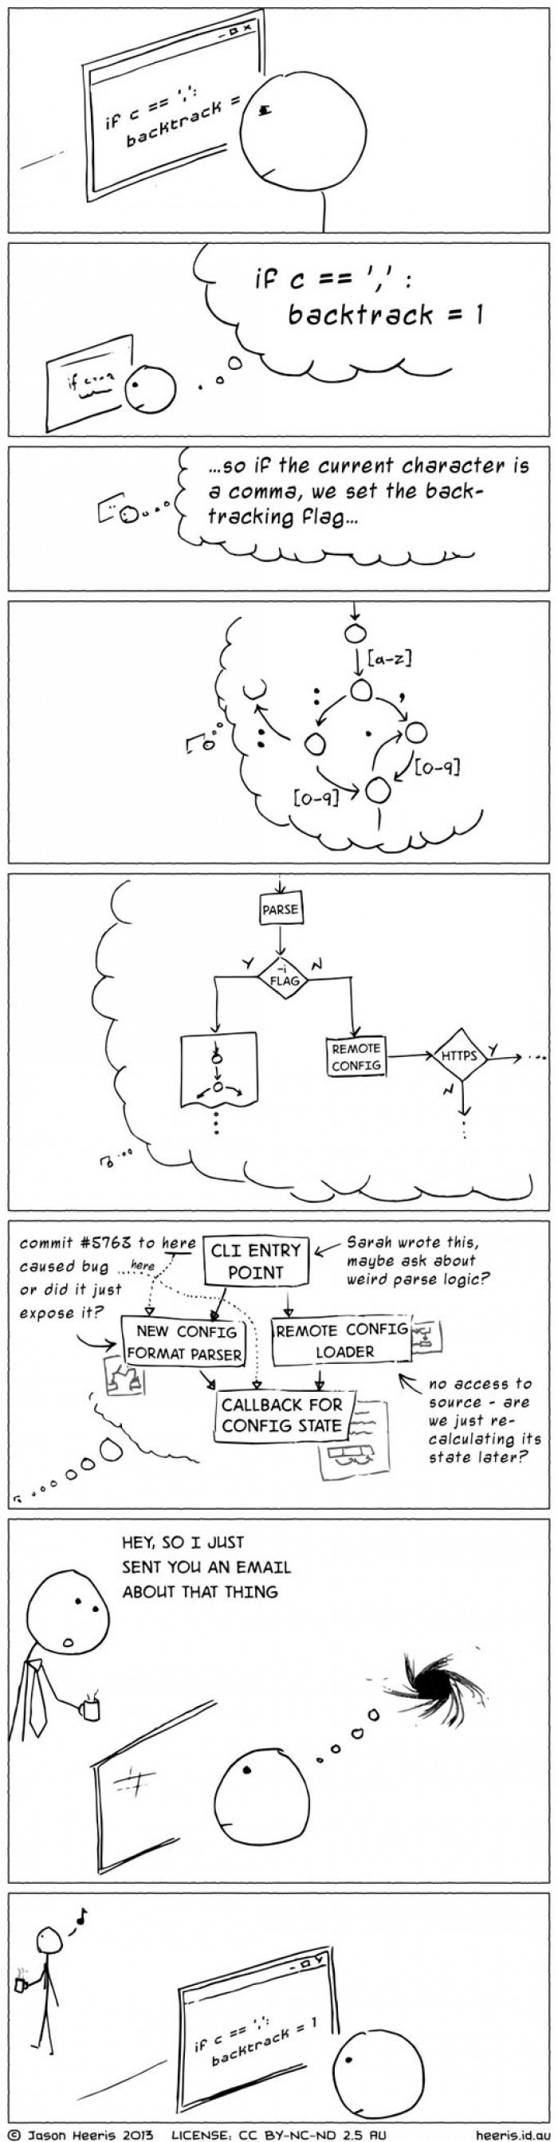
6
1
2
7
3
4
5
Never interrupt a programmer!
8

Slide 11
Outline
Part 1, Dialogue: Team Structure
Part 2, Translating: The Internet of Things

Slide 12
The 1st paragraph
No discussion of the future Internet would be complete without mentioning the Internet of things, also sometimes referred to as the industrial Internet.

Slide 13
The 2nd paragraph
Internet technology is spreading beyond … to …
Internet technology is spreading beyond the desktop, tablet computer, and beyond the smart phone, to consumer electronics, electrical appliances, cars, medical devices, utility systems, machines of all types, even clothing—just about everything that can be equipped with sensors that collect data and connect to the Internet, enabling the data to be analyzed with data analytics software. ... …
独立分词结构，修饰everything，作补充说明
that从句修饰everything
that从句修饰sensors
desktop/laptop/tablet computer
桌面电脑/笔记本电脑/平板电脑

Slide 14
The 2nd paragraph
The Internet of Things builds on …, and is being enabled by …
… … The Internet of Things builds on foundation of existing technologies, such as RFID, and is being enabled by the availability of low cost sensors, the drop in price of data storage, the development of “big data” analytics software that can work with trillions of pieces of data, as well implementation of IPv6, which will allow Internet addresses to be assigned to all of these new devices. … …
which从句修饰implementation of IPv6
that从句修饰analytics software
RFID (Radio Frequency Identification): 射频识别技术
译文：物联网建立在现有技术的基础上，如射频识别技术（RFID)。随着低成本传感器的可用性提高，数据存储费用的降低，可以处理万亿数据的大数据分析软件的发展，以及允许为所有这些新设各分配互联网地址的IPv6技术的实现，物联网逐渐成为可能。

Slide 15
The 2nd paragraph
… … Funding and research for the Internet of Things is being spearheaded by the European Union and China (where it is known as the Sensing planets), and in the United States by companies such as IBM’s smarter planet initiatives.
spearhead [ˈspɪrhed]
n. 矛头; 先头部队; 先锋, 前锋; 枪尖 vt. 带头; 当…的先锋
1. The new managing director will act as spearhead of the campaign.
新上任的常务董事将在这场运动中挂帅。
2. Since the beginning of this year, the Chinese government has continued to spearhead a self-targeted revolution by substantially streamlining administration and delegating powers and promoting market-based reforms so as to boost the vigor of creation and innovation for more individuals and businesses.
今年以来，中国政府继续带头自我革命，大幅度简政放权，推进市场化改革，让更多的人、更多的企业展现创造创新的活力。

Slide 16
The 3rd & 4th paragraphs
Although challenges remain before the Internet of things is fully realized, it is coming closer and closer to fruition [fruˈɪʃn].
Today, the Internet of things is in its early stages and is mostly used to monitoring things from afar. For instance:
Ranchers ([ˈræntʃər]牧场主;农场主) are using wireless sensors on cattle to alert the rancher if a cow gets sick or lost.
Wearable health tech lets doctors monitor patients with chronic illnesses。
Sensors on household appliances can alert the manufacturer if an appliance needs maintenance or repair.

Slide 17
The 5th & 6th paragraphs
Eventually, the Internet of things will do more than just alert you to the whereabouts (行踪) or condition of something. Devices will talk to each other and grow autonomous. This is often called machine to machine technology (M2M).
Examples include:
Cars that driver themselves.
Traffic lights that automatically respond to traffic jams or an accident, directing cars away from troubled areas.
Buildings that automatically turn the lights and heat off when they detect no one is in the room.

Slide 18
The 7th, 8th, 9th, and 10th paragraphs
Eventually, every item in the supply will be tracked and “smart”.
The whereabouts of coworkers will be instantly available, too.
“Employees on every level will be able to perform their functions more efficiently,” says W. David Stephenson, a consultant with INEX Advisors.
This will alter how manager run companies, getting rid of hierarchical decision makers—the classic role of the boss. “That, in my mind, will be the greatest business benefit of the Internet of Things,” Stephenson says.
独立分词结构，作补充说明

Slide 19
The remaining paragraphs
As cool as the Internet of Things sounds, there is a downside （缺点）. Issues such as privacy, reliability, and control of data still have to be worked out.
But even so, there is no stopping the Internet of Things now. Within a few years, it will be like mobile phones and broadband – you won’t know how you ever lived without it.
work out 解决;作出;锻炼;
figure out 想出;解决;计算出;弄明白
1. To work out a plan, one has to start with investigation.
制定计划要从调查研究入手。
2. I could work out that problem standing on my head.
我解决那个问题易如反掌。
3. It took them about one month to figure out how to start the equipment.
他们花了大约1个月的时间才搞清楚如何启动设备。

